Slide 1


Rainfall Prediction

Slide 2


Shivasharane Akkamahadevi
Government Women’s Ploytechnic
Shiralakoppa
Project Seminar On
“Rainfall Prediction-Mini Project”
Under the Guidance of :
Presented By :
“Umesha D K”
Lecture, department of CS&E,
Shivasharane Akkamahadevi Government
Women’s Polytechnic Shiralakoppa.
VI – Sem, CS&E,
SAGWPT Shiralakoppa.

Slide 3
01.
Abstract
02.
Introduction
03.
Problem Statement
04.
Objectives
Table of
Contents
05.
Existing System
06.
Proposed System
07.
Requirements
08
Implementation
09.
Results/Output
10.
Conclusion
Notes:
i

Slide 4

Our project uses machine learning to forecast rain. We analyze past weather data and use smart algorithms to make predictions. In our presentation, we'll explain how we did it, share the data we used, and show how well our model works. Our goal is to enhance weather predictions for the benefit of the general public and society.
Abstract
01.
Rainfall Prediction

Slide 5

02.
Introduction
Rainfall prediction is all about guessing, rain is going to fall or not. We use this to plan our daily activities, manage farms, and even get ready for storms. Accurate rainfall forecasts are like a weather crystal ball that helps us make decisions and stay safe. Thanks to modern technology and weather experts, we're getting better at predicting rain, which is making our lives easier and safer.

Slide 6


Problem
Statement
03.
Accurate rainfall forecasting is essential to mitigate the adverse impacts of heavy and erratic rainfall, which can lead to crop damage, property destruction, and natural disasters like floods and droughts. To address this, the project focuses on developing a precise rainfall prediction model.

Slide 7

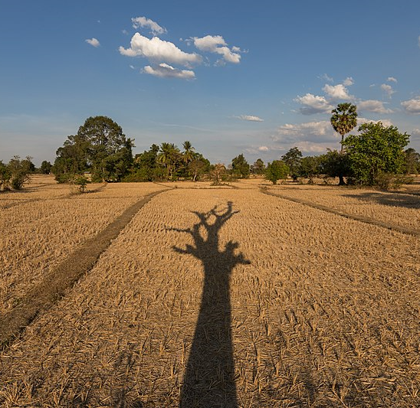
04.
Objectives
The goal of rainfall prediction to provide advance knowledge of whether the rain will occur or not, enabling better preparation and informed decision-making across various sectors, from agriculture and water resource management to disaster response and public safety..

Slide 8

Existing System
05.
Agriculture is the strength of our Indian economy. Farmer only depends upon
monsoon to be their cultivation. The good crop productivity needs good soil,
fertilizer and also good climate. Weather forecasting is the very important requirement of the each farmer. Due to the sudden changes in climate/weather, The people are suffered economically and physically. Weather prediction is one of the challenging problems in current state.

Slide 9
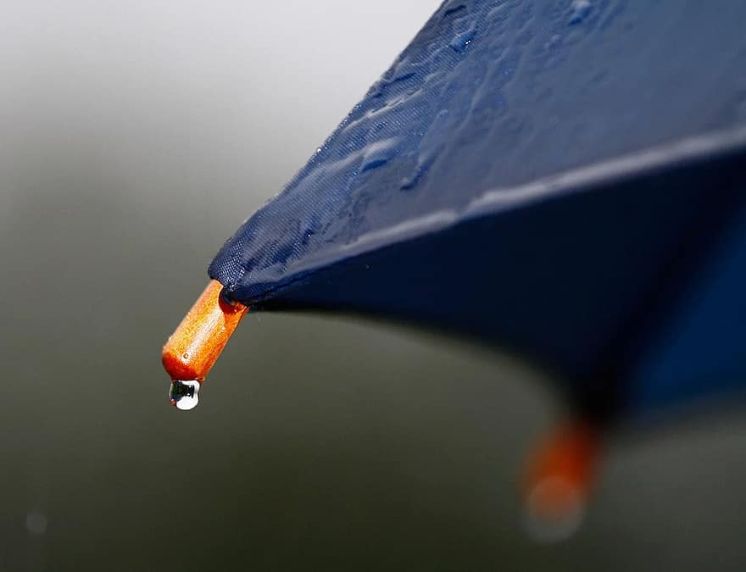

Proposed
System
06.
Rainfall is vital for agriculture, water resource management, and nature-related activities. Prolonged dry spells or excessive rain during critical crop growth stages can drastically reduce crop yields. In agricultural countries like India, where the economy heavily depends on crop productivity, accurate rainfall prediction is crucial. Rainfall forecasting remains a formidable scientific and technological challenge worldwide.

Slide 10



07.
Requirements
Hardware Specification:
Software Requirements:
Processor : Intel core 15
Processor Speed : 1.75GHZ to 2.40GHZ
RAM : 4GB
Hard Disk : 4GB to 30GB
Language : Python
IDE : Jupyter Notebook
Operating System : Windows 8/10
Framework : Flask

Slide 11

09.
Implementation
USER
INPUT DATA
PREPROCESSING OF DATA
SPLITTING OF DATA
TRAINING
TESTING
RESULT

Slide 12
Result/Output
The performance of various Machine Learning algorithms and predict the most accurate algorithm for the predicting of rainfall. This research was done using techniques of Logistic Regression, Random Forest, Decision Tree, Support Vector Machine on the dataset.
Method | Classification Accuracy | Precision
Random Forest | 72% | 77%
Logistic Regression | 76% | 79%
Decision Tree | 68% | 78%
Support Vector | 73% | 78%

Slide 13
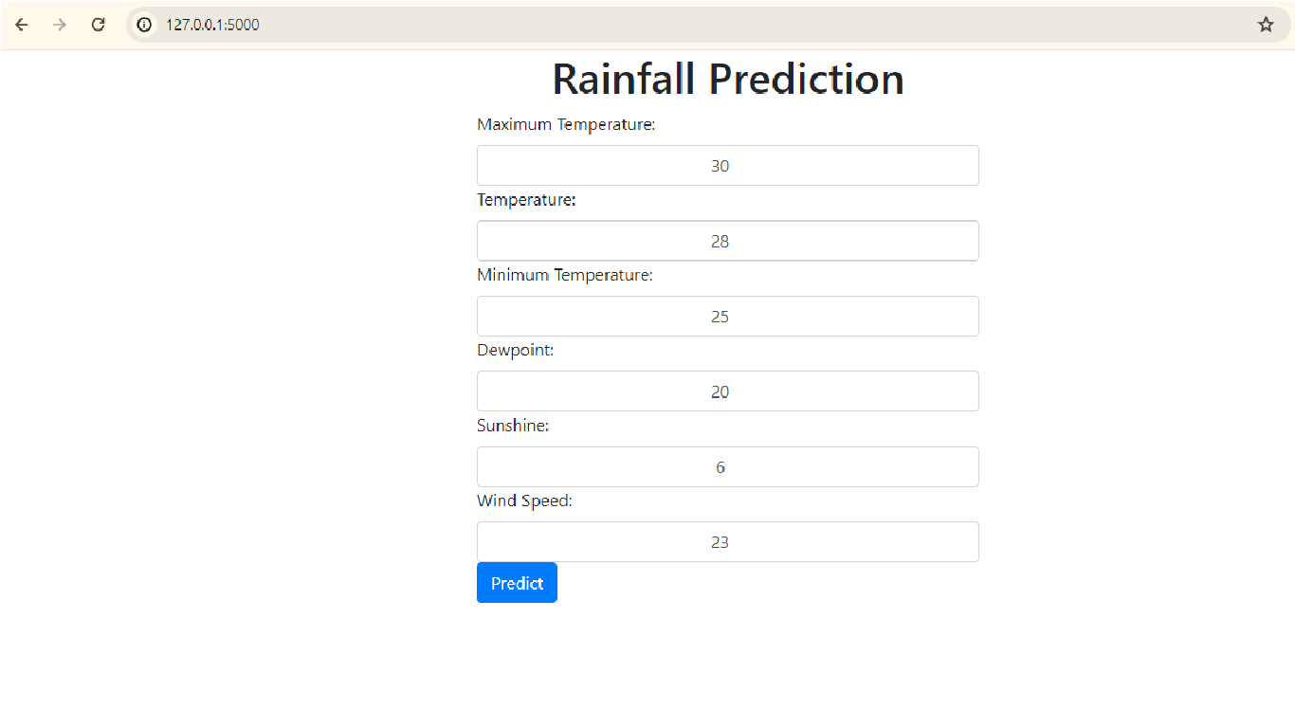
Home Screen
Here user can enter input details.

Slide 14
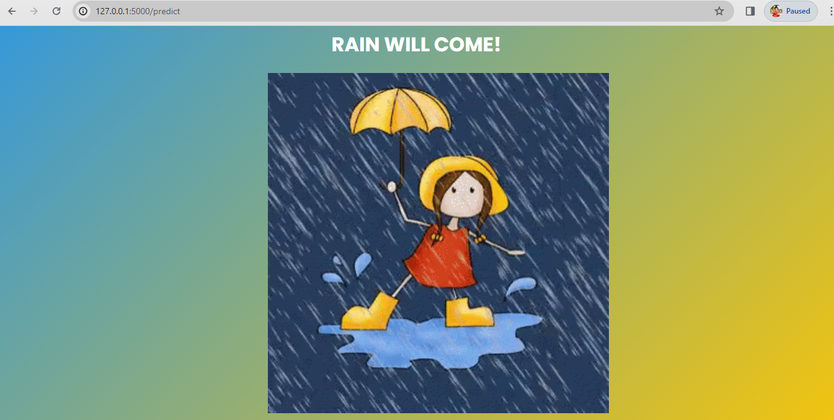
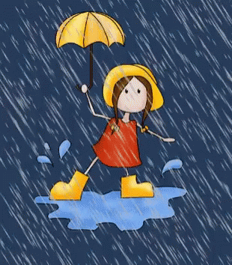
Output1: Rain will come!

Slide 15


Output2: No Rain!

Slide 16

12.
Conclusion:
In this research, we use different machine learning techniques to make rainfall predictions more accurate. Among these techniques, Logistic Regression achieves a 76% accuracy, Random Forest classifier and Support Vector Classifier both reach 72%, while Decision Tree lags slightly with 68% accuracy. To enhance our predictions, we can explore other methods like time series, clustering, association rules, and ensemble techniques. Achieving better accuracy will require more complex models and gathering region-specific data. This research highlights the potential for improving the precision and accuracy of rainfall prediction systems.

Slide 17

Thank You!
Thanks For Your Attention...

